Slide 2
Unit 4 Text B
Fashion Passes, Style Remains

Slide 3
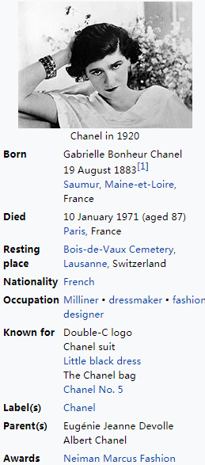
Have you ever heard of Chanel?
Fashion passes, style remains.
嘉布麗葉兒·波納·香奈兒，是法國先鋒時裝設計師，著名法國女性時裝店香奈兒品牌的創始人。 她現代主義的見解，男裝化的風格，簡單設計之中見昂貴，成為20世紀時尚界重要人物之一。她對高級定製女裝的影響令她被時代雜誌評為20世紀影響最大的100人之一。

Slide 4
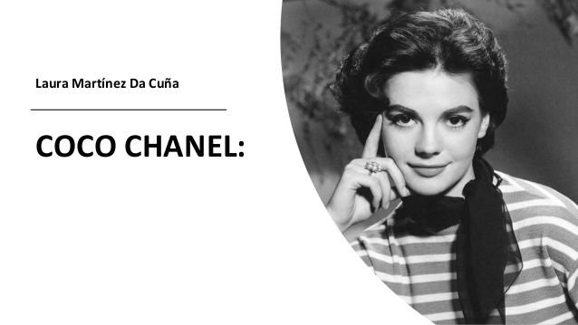


Slide 5
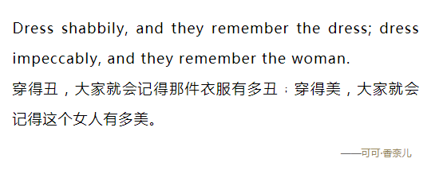
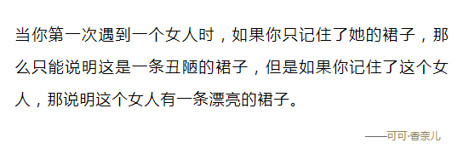
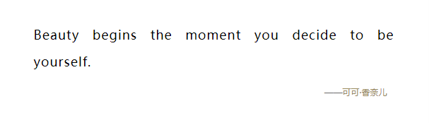
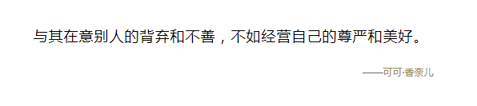
A girl should be two things: classy and fabulous
每个女孩都该做到两点：有品位并光芒四射。

Slide 6
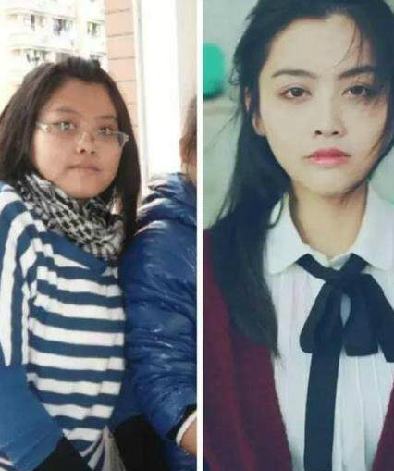
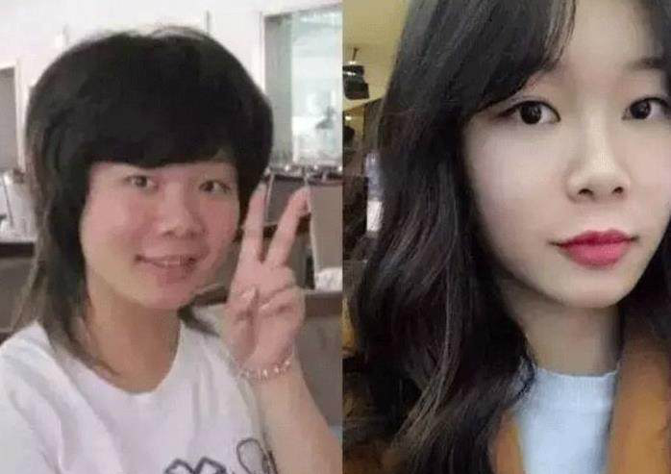
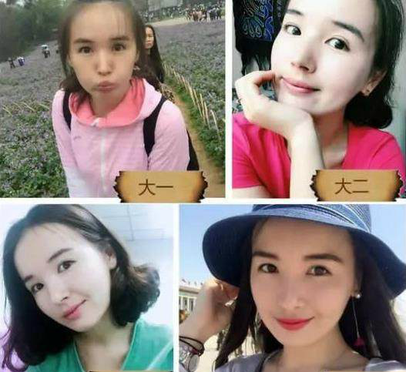
女生大学四年的蜕变，对比照堪比整容

Slide 7
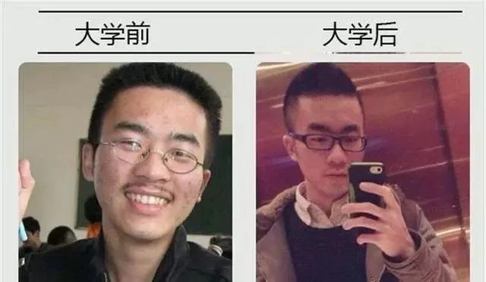
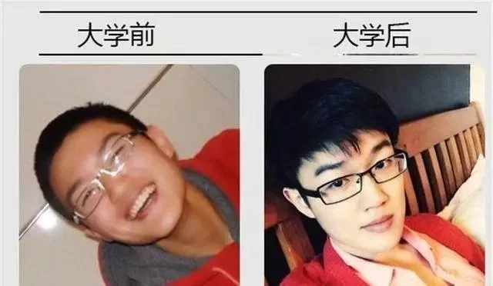
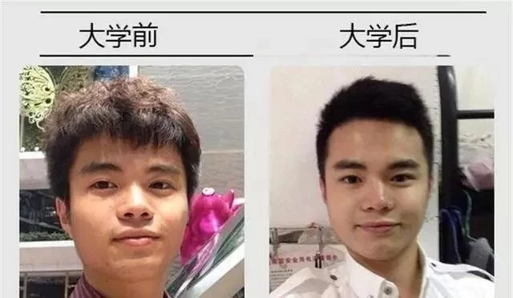
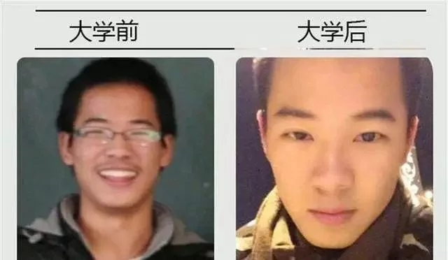

Slide 8
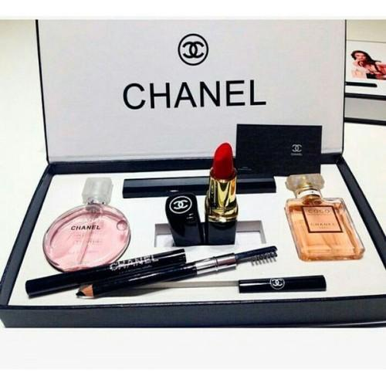
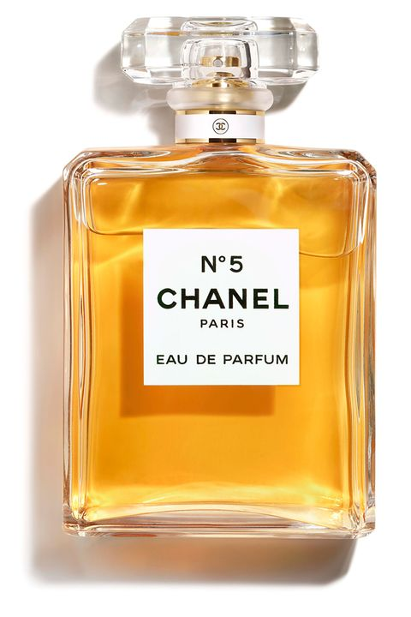
The products of Chanel

Slide 9
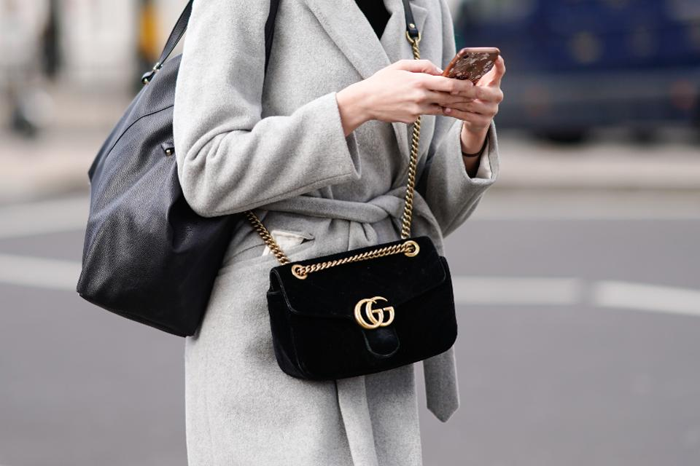
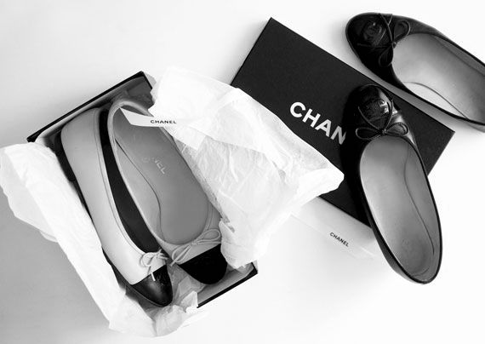
The products of Chanel

Slide 10
Text B: Fashion Passes, Style Remains
Skimming for structure
Introduction
Para _____
1
Body
Para _____
2-6
Conclusion
Para _____
7

Slide 11
trendless
The feature of fashion
Fashion design is fast, ,comfortable and .
personal
Introduction
(para1)

Slide 12
shapeless
Fashions designs have become .
why
avenues
Social media have offered many for people to understand better fashion designs.
Body: changes of fashion
(para2)
expression
Street fashion trend is more of an of personality and life style than of fashion designs generally.

Slide 13
famous people
before: set fashion trends
professionals
send out their fashions styles to the world
Body: changes of fashion
bloggers
now: of fashion
(para3)
average people

Slide 14
starts embodying many of elements of various cultures
varieties
why
the information age
globalized
a much world community
Body: changes of fashion
(para4,5)
outlook
transform in its and concept

Slide 15
starts embodying many of elements of various cultures
varieties
examples
before: jeans monopolizing youth culture in?
U.S.A.
Japan
Body: changes of fashion
other countries
(para4,5)
Korea
ethnic
Fashion designers of various background convey their outlook into their design.
now:
Ethnicity
 is no longer the only factor that affects the fashion trend.
taste
lifestyle
People are guided by their , and experiences.

Slide 16
Fashion designers of various background convey their outlook into their design.
ethnic
Ethnicity
now:
 is no longer the factor that affects the fashion trend.
taste
lifestyle
examples?
People are guided by their , and experiences.
minimalism
Alexander Wang’s simple power women’s look has won a lot of fans of .

Slide 17
before: Fashion had its own .
standard rules
gender
now: Fashion isn’t strictly ordered by .
come forth a new class of fashion named .
unisex
clothing lines can be worn both sexes
embody personal brand
why
(para6)
equalities
greater between men and women
punk
The trend was originally designed of socially dissatisfied youth’s.
Everyone’s unique design can be called his or her fashion.
haunted
Today it has been even by designers.
couture

Slide 18
the concept of fashion
the price and accessibility
Conclusion: fashion has .
equate
Price does not good fashion.
evolved
(para7)

Slide 19
  culture background

Slide 20
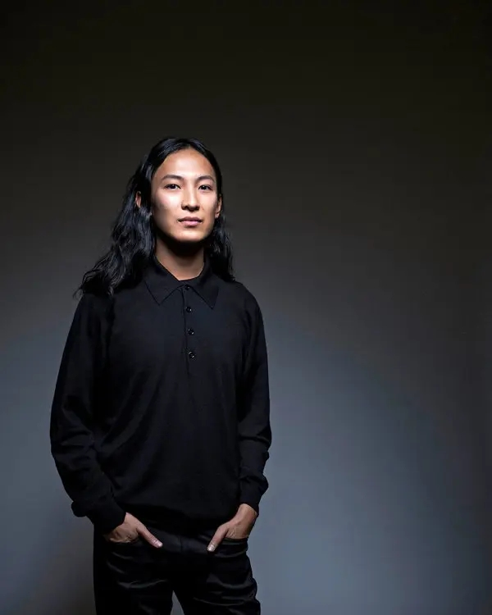
Alexander Wang
王大仁，知名美籍華裔時裝設計師，出生於美國加州，並在紐約州開創了個人事業。 王大仁的設計以注重細節為重，紐約東區是他的設計靈感來源之一。喜歡極限運動的年輕人很容易在他的設計中找到自由不羈的理念，同時王大仁的設計對奢華的時尚風不屑一顧。

Slide 21
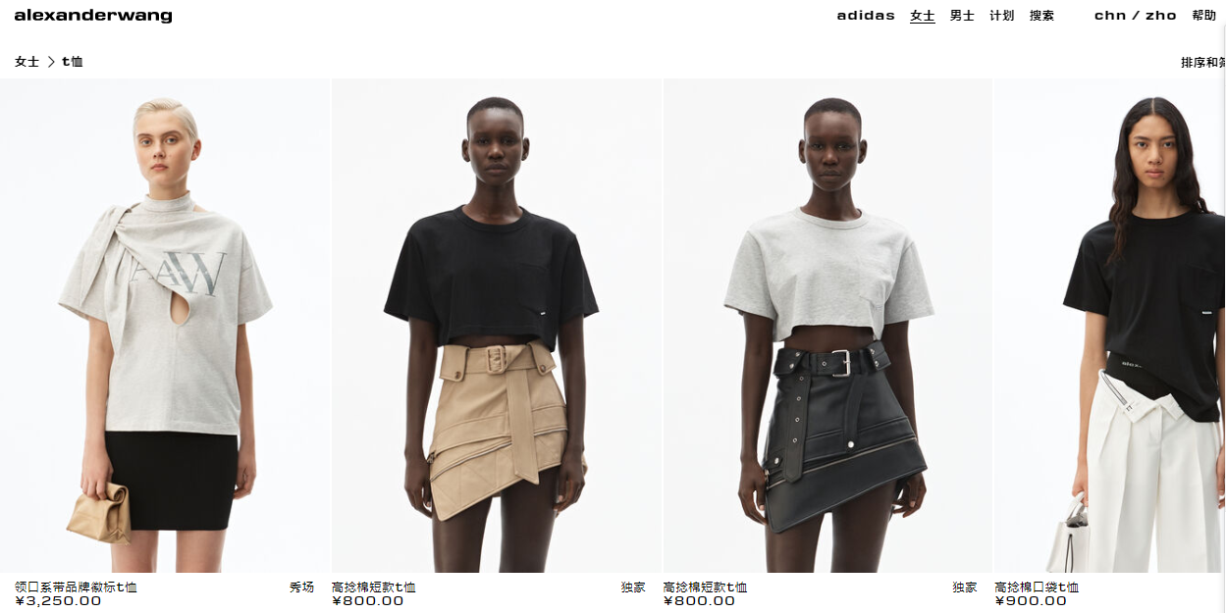

Slide 22
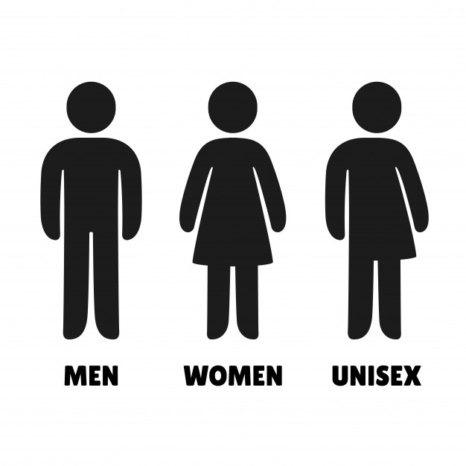


Slide 23
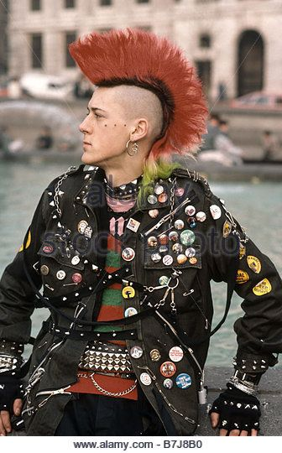
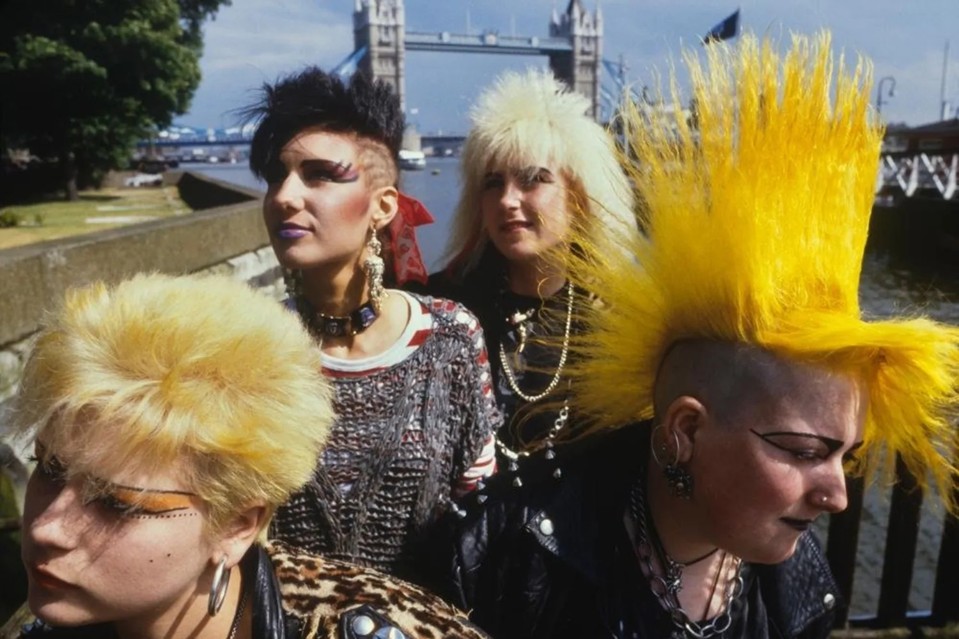

Slide 24
1 Who set the fashion trends?
A. Famous people. B. Ordinary people. C. The professionals. D. All of the above.
2 Nowadays, fashion trends has embodied _____________ brand.
A. personal B. social C. global D. nobody
3 The unisex means that ______________.
A. clothing lines cannot be worn by man and woman.
B. clothing lines cannot be worn by man.
C. clothing lines cannot be worn by woman.
D. clothing lines can be worn by man and woman.
D
A
D

Slide 25

C
4 Which one of the following statements is NOT true according to the text?
A. The fashion trend is changing fast.
B. The street fashion is one of the most common forms of fashion.
C. The American style is the standard of fashion nowadays.
D. The cost of fashion has become lower than before.
5 The fashion has evolved in the aspect of _______________.
A. concept of fashion B. price C. accessibility D. all of the above.
D

Slide 26
  Language focus
（两边有树或高楼的）大街；（乡间宽阔的）林荫大道
Fremont Avenue弗里蒙特大街
avenue
方法；途径；渠道
blog
博客
blogger
写博客的人

Slide 27
  Language focus
垄断；包办；实行…的专卖
monopolize
霸占；独占；完全控制

Slide 28
  Language focus
民族的；种族的
ethnic
异族的；具有民族特色的；异国风味的

Slide 29
  Language focus
尤指20世纪70年代末服装、发型怪异，通过骇人的举止和吵闹的快节奏音乐对抗权威的年轻人的文化。
punk
小流氓，阿飞

Slide 30
  Language focus
不分性别的；男女皆宜的
unisex

Slide 31

  Language focus
Practical Phrases | Meanings
1. to some extent | 某种程度上
2. no longer | 不再
3. for instance | 例如
4. come forth | 出现

Slide 32


Language focus
Practical phrases
某种程度上
短语逆译
to some extent
短语应用
一定程度上，她要为事故负责任。
提示
To some extent, she was responsible for the accident.

Slide 33
Language focus
Practical phrases
不再
短语逆译
no longer
短语应用
他已经不在北京住了。
提示
He no longer lived in Beijing.
He didn't live in Beijing any longer.

Slide 34
Language focus
Practical phrases
例如
for instance
短语逆译
短语应用
还有比开卡车更危险的工作，例如训虎、灭火。
提示
There are jobs more dangerous than truck driving，for instance，training tigers，fire fighting.

Slide 35
assignment
1. Review the vocabularies and difficult sentences.
2. Learn more things about fashion.

